Slide 1
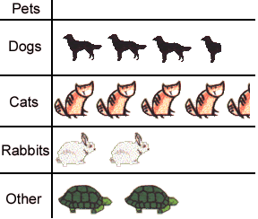
Key
1 animal = 10 owners
Which is the most popular pet?
How many dogs are there?
How many more cats are there than rabbits?

Slide 2
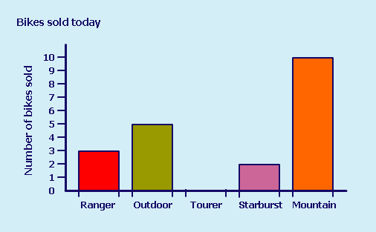
Which is the most popular type of bike sold?
How many Tourers were sold?
How many Ranger and Outdoor bikes were sold altogether?

Slide 3
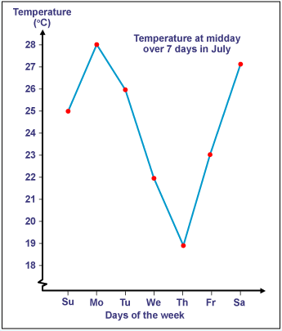
Which day of the week was coldest?
How much hotter was Monday than Sunday?

Slide 4
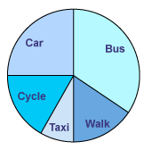
What is the most common method of travel?
What fraction of students travel to school by car?
If 6 students travel by car, how many took part in the survey?

